Slide 1




BEAN VOYAGE CAFE
FRENCH ECHT CAFE

Slide 2
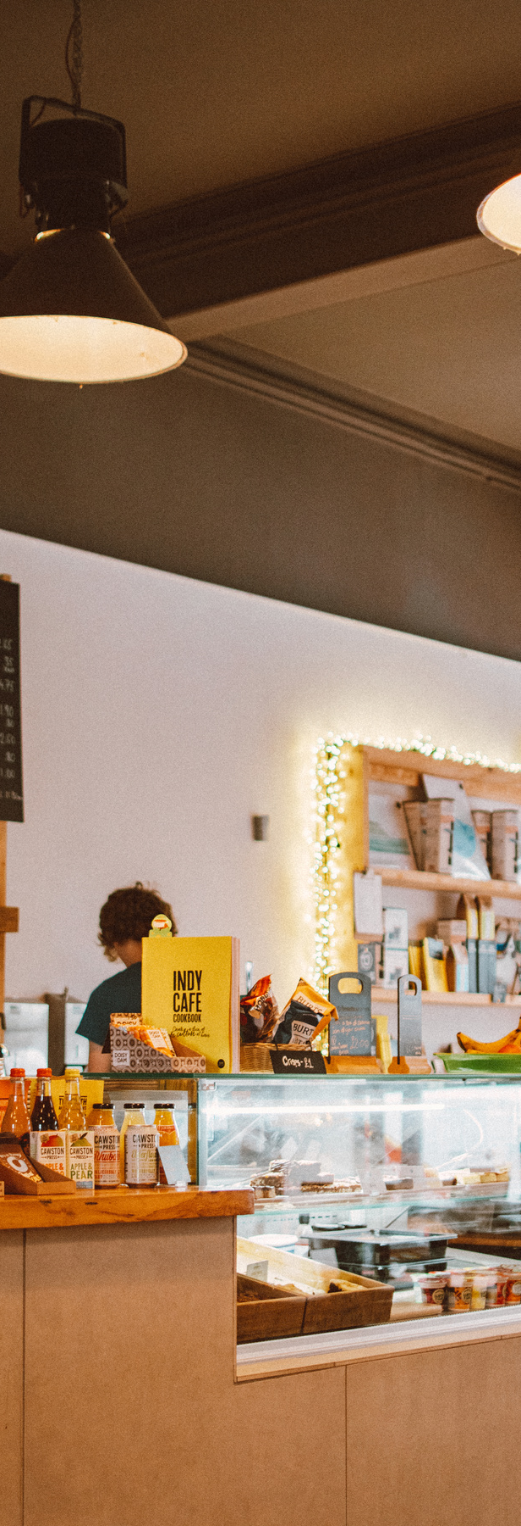

INDEX
TECH
USED
REFERENCES/
LINKS
INTRODUCTION
MEMBER
ROLES
KEY
FEATURES
RESULT

Slide 3
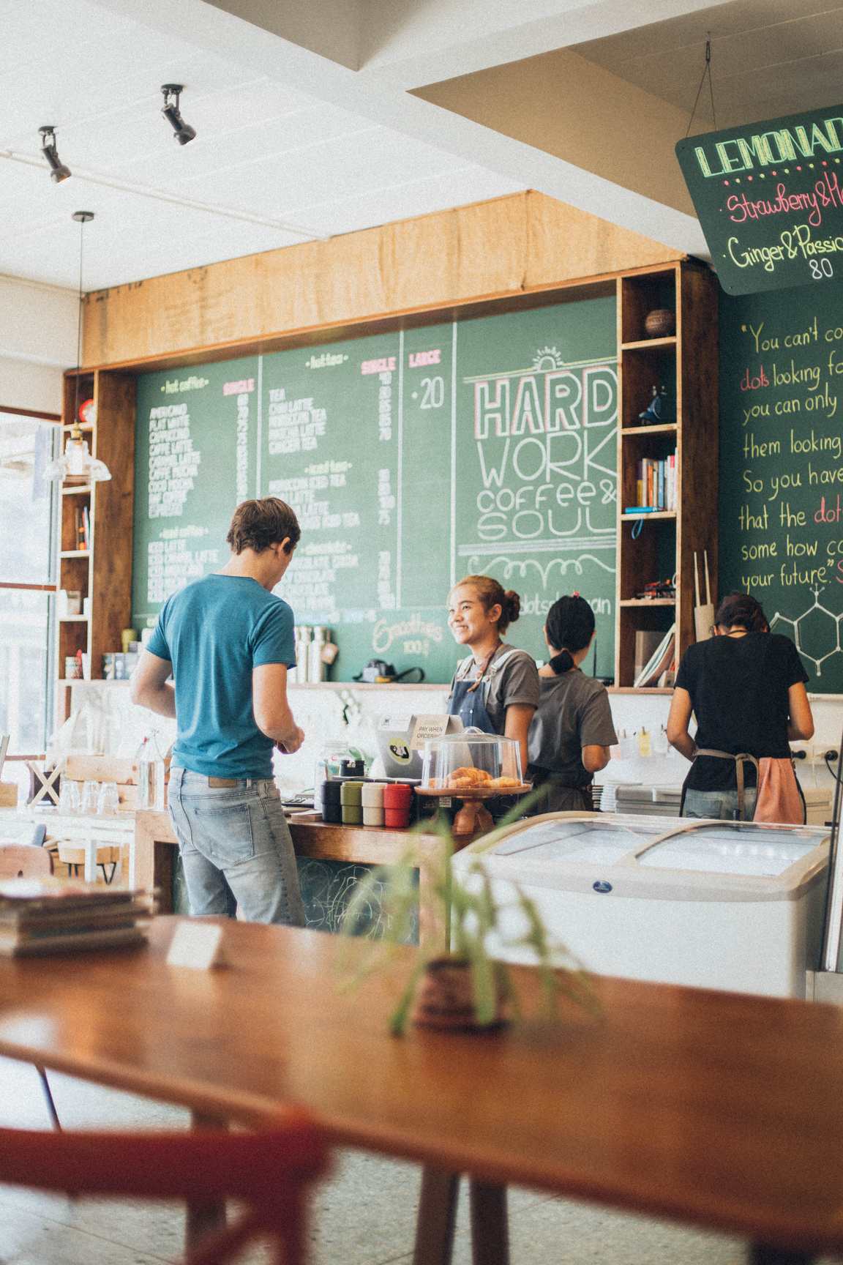

TEAM MEMBER ROLES
JAY SONI
Home page, PPT
JASNOOR SINGH
Login Page , Project Report , Drinks
JYOTI DHAMIJA
About Us , Food
PROJECT MENTOR
Mrs. Shinnu Jangra

Slide 4
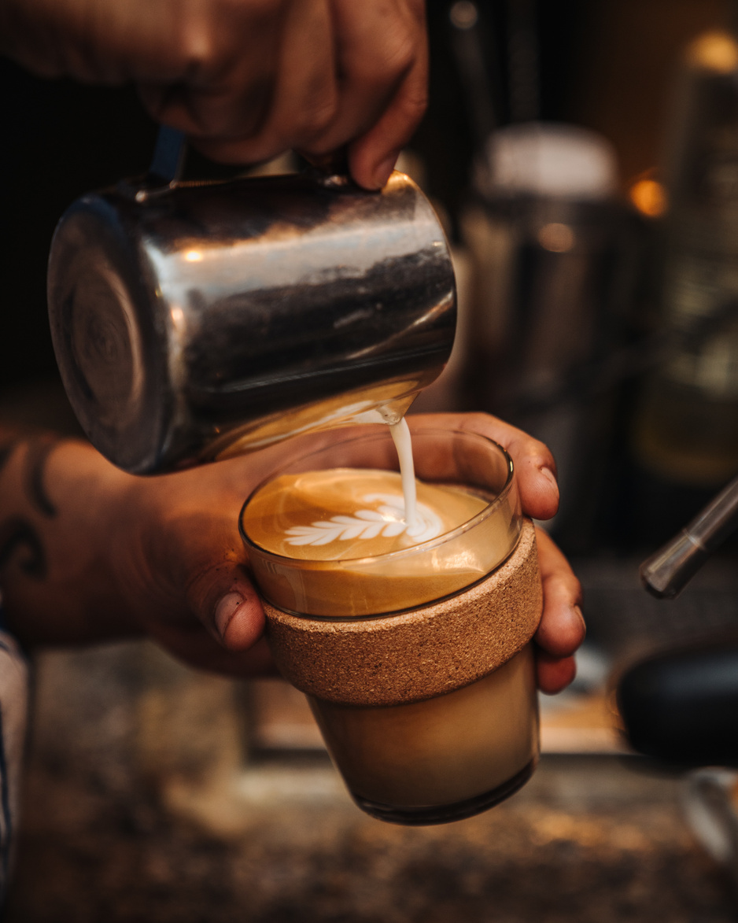
INTRODUCTION
Explore the digital paradise of Bean Voyage Cafe - an immersive online platform designed to bring the warmth and excitement of a traditional cafe experience directly to your screen.

Slide 5
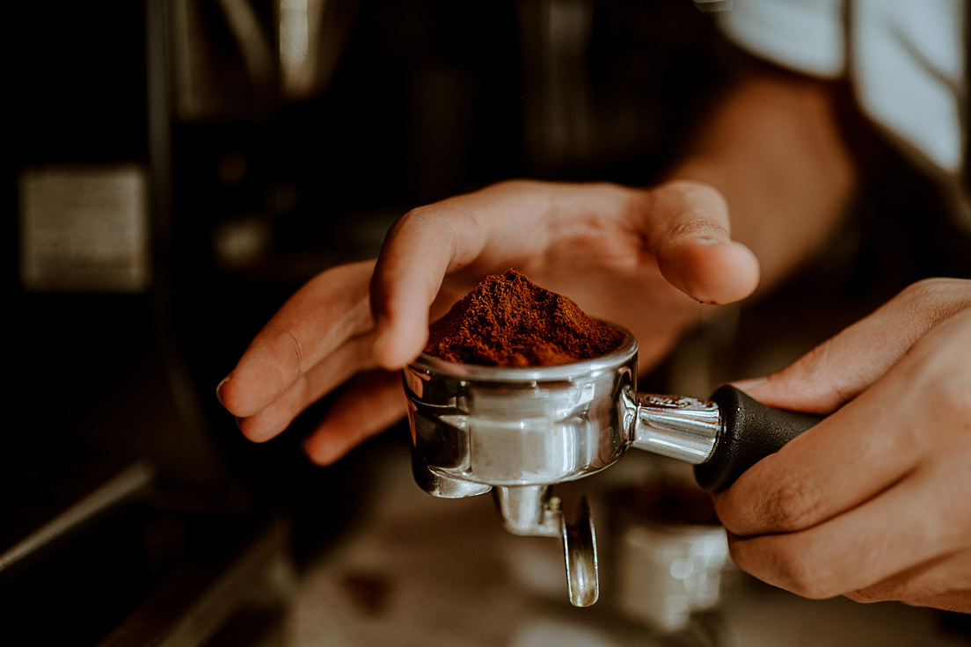
KEY FEATURES
Fast Loading Times
The webpages load quickly, providing users with a seamless and efficient browsing experience.
Homepage:
Eye-catching visuals, High-quality images of the cafe, menu items, and ambiance. Easy navigation, Intuitive menu and links to key sections.
Responsive Design:
Bean Voyage Cafe's website is built with a responsive design, ensuring that the layout and content adapt seamlessly to various screen sizes and devices. Whether you're browsing on a desktop, tablet, or smartphone, the website provides an optimal and visually appealing experience, enhancing accessibility for users across different platforms.

Slide 6
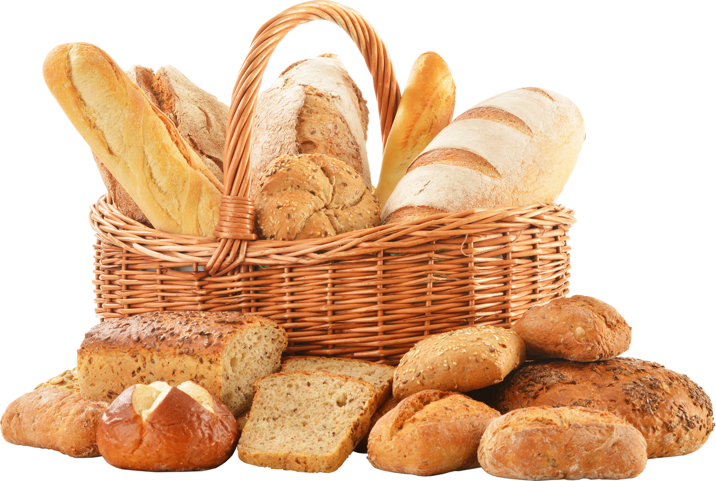
TECHNOLOGY USED
Tools and platforms used to create this website:
HTML
CSS
BOOTSTRAP
JAVASCRIPT
VS Code Editor
Microsoft Edge
Chrome Browser

Slide 7
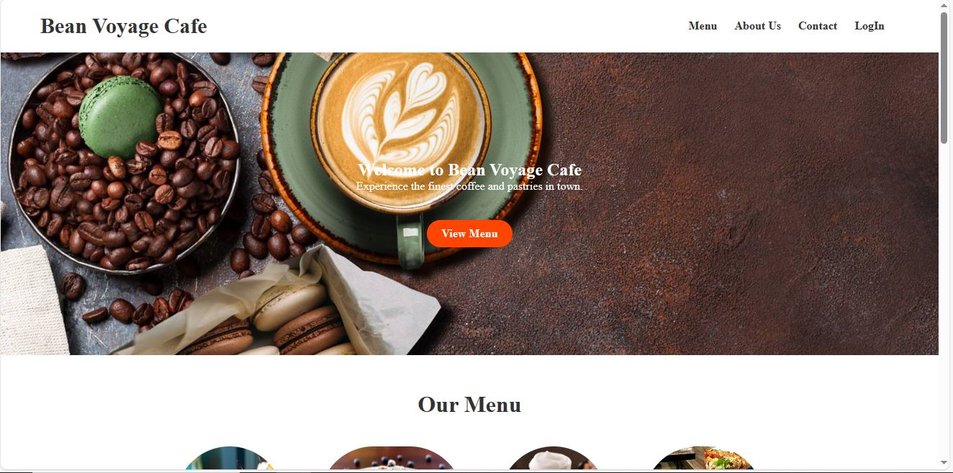
RESULT
Home Page
Fig 1. Home Page

Slide 8
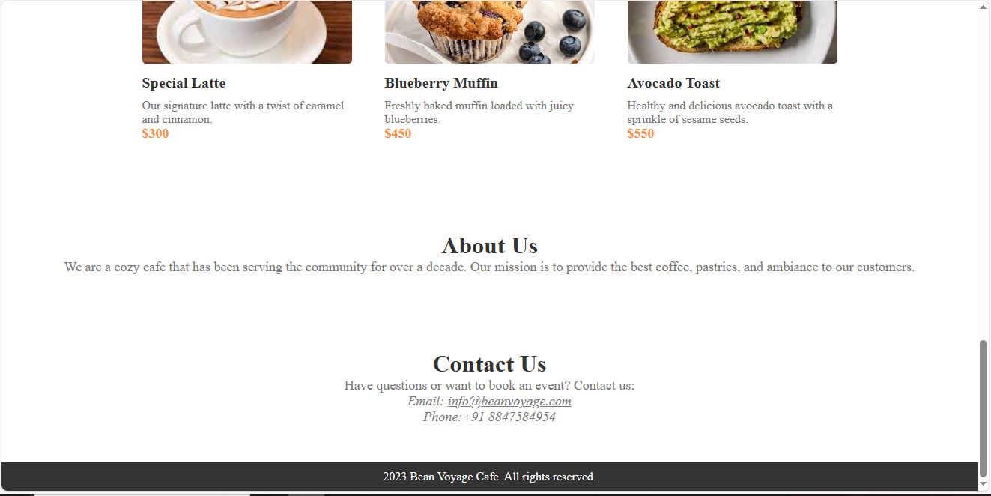
RESULT
Home Page
Fig 2 . Home Page

Slide 9
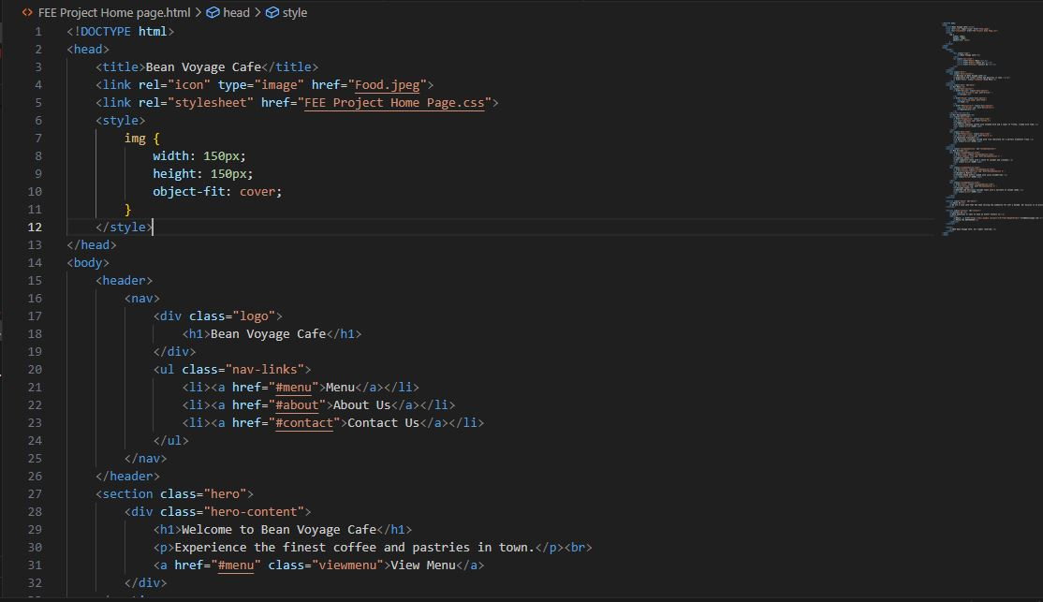
RESULT
Code Snipets
Fig 3 . Home Page HTML Code

Slide 10
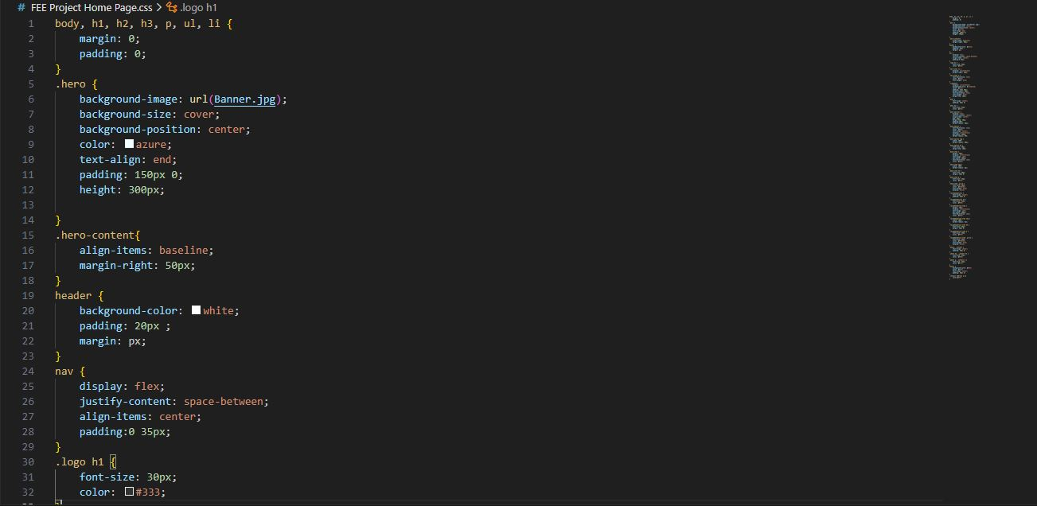
RESULT
Code Snipets
Fig 4 . Home Page CSS Code

Slide 11

REFERENCES
The reference source points used are :
https://www.google.com/
https://www.w3schools.com/
https://www.youtube.com/
Mrs. Shinnu Jangra

Slide 12

THANK YOU VERY MUCH!!

